Slide 1
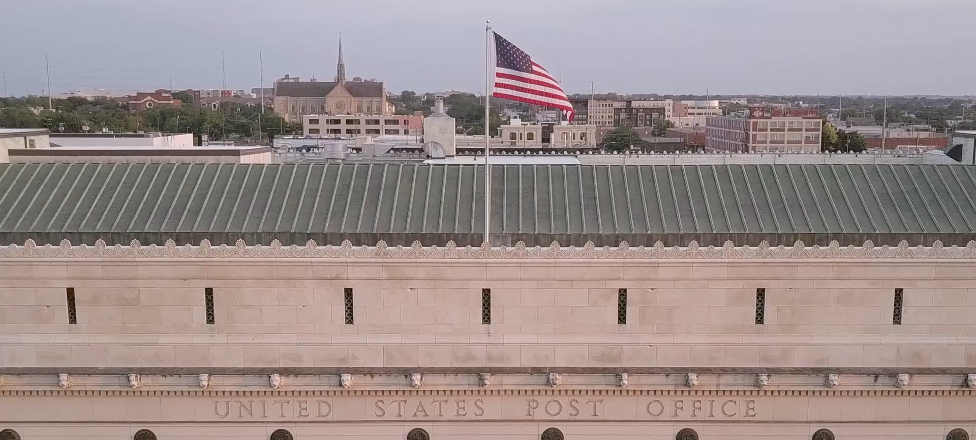



UNITED STATES POSTAL INSPECTION SERVICE

Slide 2
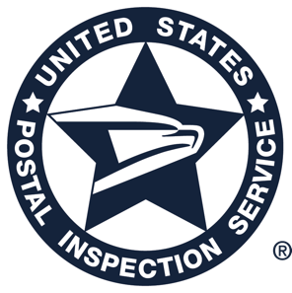

U.S. MARSHALS
FOUNDED IN
1789
1908
FBI FOUNDED IN
We are the oldest and most trusted federal law enforcement agency
1972
ATF FOUNDED IN
POSTAL INSPECTION
SERVICE FOUNDED IN
1775
1973
DEA FOUNDED IN
2003
CBP FOUNDED IN
Notes:
The United States Postal Inspection Service is one of the nation’s oldest law enforcement agencies, tracing its roots back to August 7, 1775 – the earliest recorded date that William Goddard served as the first Surveyor General of Post Roads.

Slide 3


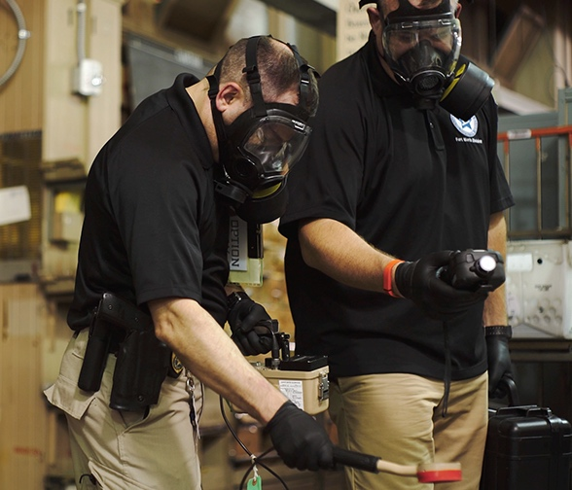
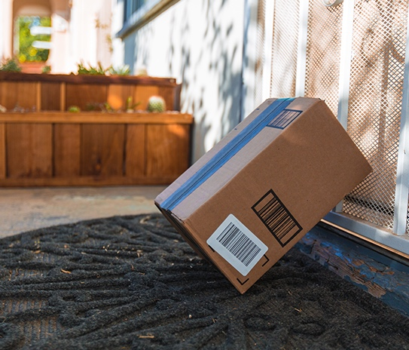
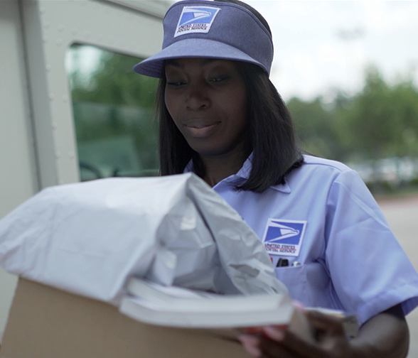
OUR MISSION
Secure the Nation’s
Mail System
Ensure Public Trust
in the Mail
Protect the
Postal Service
Notes:
As the federal law enforcement, crime prevention, and security arm of the United States Postal Service, our goal is to ensure confidence in the U.S. Mail.
Each day, we work to ensure that American businesses can safely dispatch funds, securities, and information through the U.S. Mail; that Postal customers can entrust their correspondence to the mail; and that Postal employees can work in a safe environment.

Slide 4
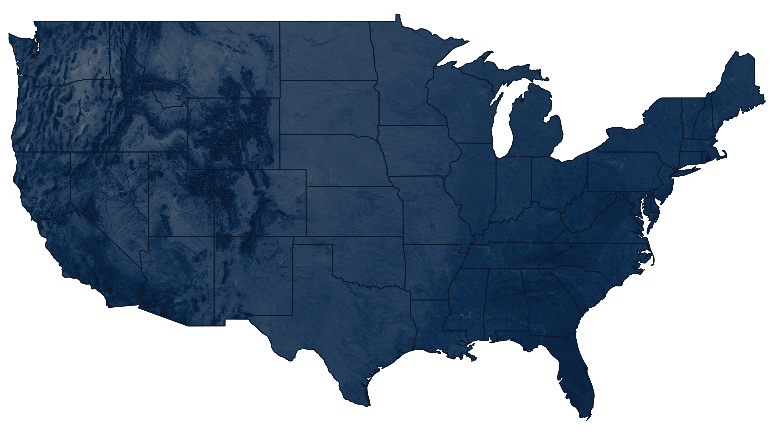
OVER 1,200 POSTAL INSPECTORS
Notes:
To assist in carrying out its responsibilities, the United States Postal Inspection Service employs more than 1,200 Postal Inspectors…

Slide 5
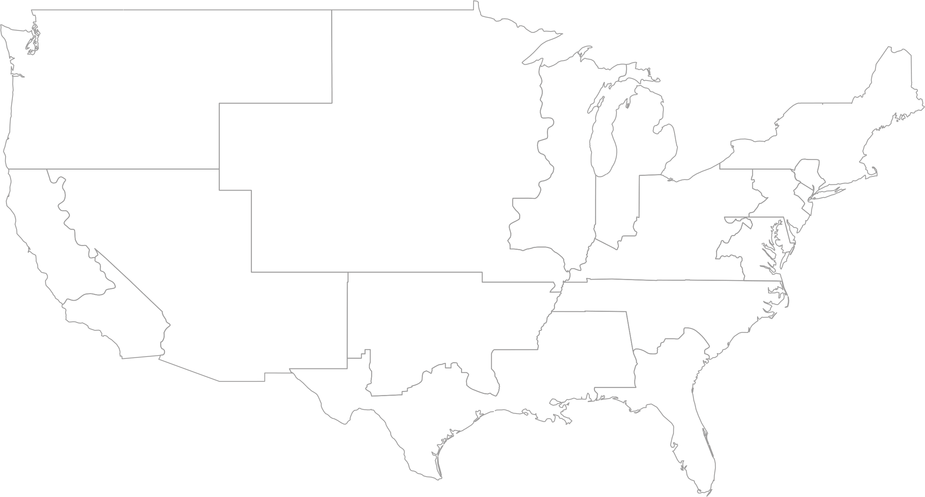
SEATTLE
INCLUDES ALASKA
DENVER
DETROIT
BOSTON
NEW YORK
CHICAGO
PITTSBURGH
PHOENIX
PHILADELPHIA
SAN FRANCISCO
INCLUDES HAWAII & GUAM
ATLANTA
WASHINGTON, DC
FT. WORTH
LOS ANGELES
HOUSTON
MIAMI
INCLUDES PUERTO RICO & U.S. VIRGIN ISLANDS
IN 16 DIVISIONS ACROSS THE COUNTRY
Notes:
…across 16 divisions nationwide, as well as uniformed Postal Police Officers and highly trained forensic scientists and technical specialists.

Slide 6
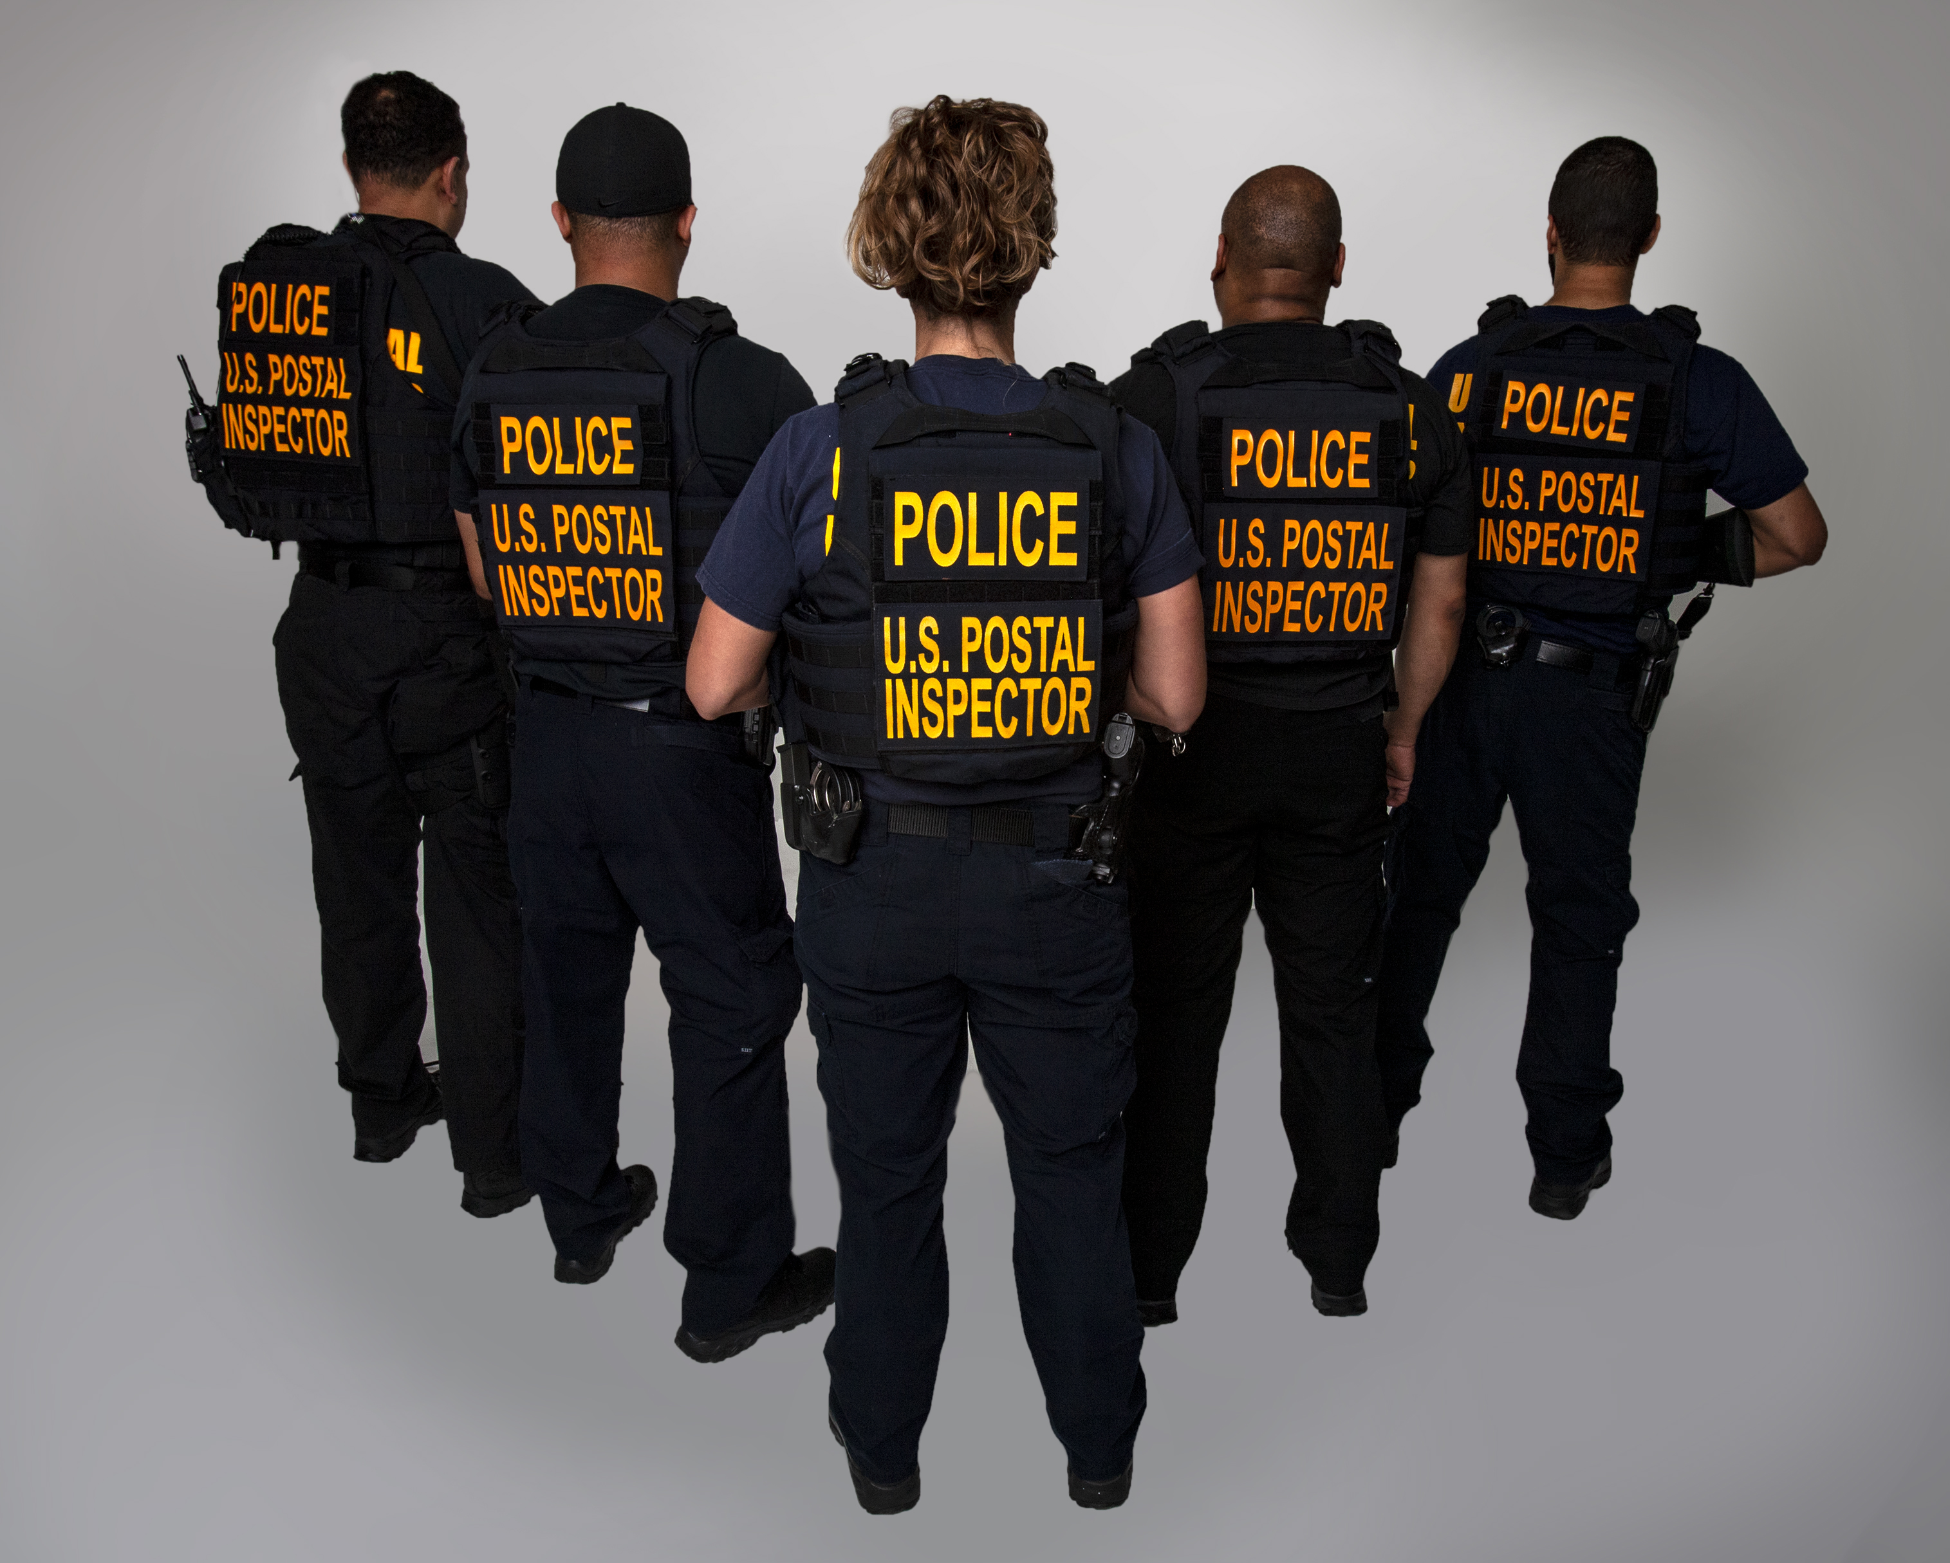
WE ENFORCE MORE THAN
200 FEDERAL STATUTES RELATED TO:
/ Narcotics
/ Violent Crimes
/ Cybercrimes
/ Dangerous Mail
/ Mail Fraud
/ Mail Theft
/ And more…
Notes:
Inspectors throughout the country enforce over 200 federal laws related to crimes that adversely affect or entail fraudulent use of the U.S. Mail, the postal system, postal employees, and customers.

Slide 7

OUR PARTNERSHIPS
DOMESTIC & International
WORKING GROUPS
  Financial Industry Mail Security Initiative
  DOJ’s Bank Fraud
  Securities & Commodities
  Mortgage Fraud
  International Mass Marketing Fraud
  National Center for Disaster Fraud
  National Cyber Forensics and Training Alliance
TASK FORCES
  President’s Identity Theft Task Force
  President’s Financial Fraud Enforcement Task Force
  Joint Terrorism Task Force
  High Intensity Drug Trafficking Areas Program
  International Organized Crime Intelligence and Operations Center
  Fusion Center at Organized Crime Drug Enforcement Task Force
PARTNERSHIPS
  Alberta
  Saskatchewan
  Toronto Strategic
  Vancouver Strategic Alliance
  Universal Postal Union
Notes:
We don’t do it all on our own…we have Partnerships both Domestically and Internationally…
Domestically, we work closely with many other federal, state and local law enforcement agencies.
We partner with members and organizations in the financial industry. And with so much mail being transported by air, the airline industry is a key partner.
We work with consumer groups to protect consumers from crimes such as fraud and identity theft. And, of course, we are key partners with you in the mailing industry.
As traditional crimes have become more sophisticated and criminals have moved beyond our borders, we have adapted.
As criminals reach back to victimize American citizens, we have formed strategic partnerships with foreign law enforcement and postal administrations.
Using the network of the Universal Postal Union, the Postal Security Group is currently upgrading the capabilities of this network to ensue, in the event of a worldwide crisis; all security officials will receive timely accurate information.
ADDITIONAL INFORMATION IF YOU WOULD LIKE TO HIGHLIGHT IT:
Financial Industry Mail Security Initiative (FIMSI)
Established in 1992 at the first Credit Card Mail Security meeting in DC, focused on how LE and credit card industry could stop credit card/convenience check theft. Now includes representatives of the mailing industry, commercial security and retail managers, and prosecutors.
President’s Identity Theft Task Force
1 of 17 federal agencies and departments, created by Executive Order in May 2006
Working group participation:
DOJ's Bank Fraud Working Group, Promotes coordination and communication between the federal law enforcement and regulatory communities;
Securities and Commodities Working Group, Promotes the exchange of information on developing trends, new laws and regulations, and law enforcement issues and techniques;
Mortgage Fraud Working Group, Focuses on important issues regarding mortgage and subprime lending fraud;
International Mass Marketing Fraud Working Group, Fosters coordination and information exchange on telemarketing and Internet fraud
National Center for Disaster Fraud – Triages reports from the public about possible fraud relating to disasters of all types.
Partnerships
USPIS participates in several cross-border partnerships with Canada, to combat Canada-based mass marketing mail fraud targeting U.S. consumers
USPIS also participates in a partnership with Jamaica (Project JOLT)
Operations
Rapid Refund – Tax fraud using SSNs from PR and other citizens. Tens of thousands of fraudulent federal and state tax returns filed in 8 states.
Homeless – Mail theft thieves along the I-95 corridor created counterfeit checks using information stolen from the mail. Indigents recruited as accomplices to assume victim identities.
Stolen Dreams & Broken Trust – Targeted financial investment fraud schemes.
Gulf Coast – Targeted fraudulent claims related to Deepwater Horizon Oil Spill
FTC Business Opportunity – Targeted small business ventures and work at home schemes
7

Slide 8

Notes:
MAKING THE CUT VIDEO

Slide 9
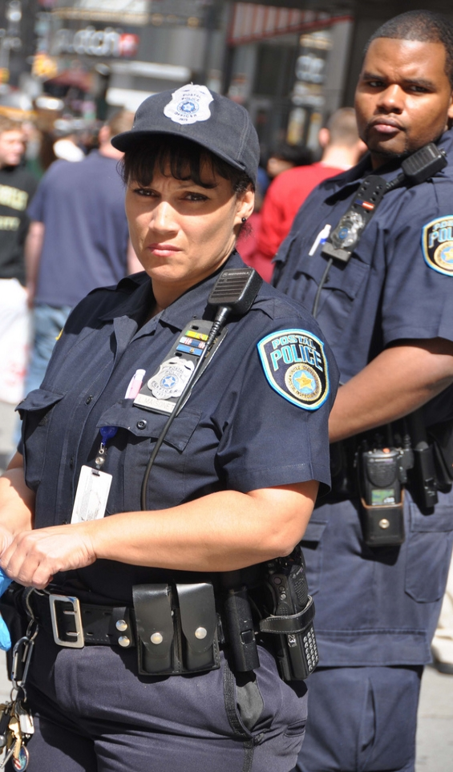

WHO WE ARE
POSTAL POLICE OFFICERS
On USPS property, PPOs safeguard Postal Service employees; the security of the U.S. Mail®, its employees, and customers; the security of the U.S. Mail system; and ensure the American public’s continued trust in the U.S. Mail.
Approximately 600 uniformed officers
21 Facilities/Divisions Nationwide
Notes:
We have approximately 600 uniformed police force who are domiciled in 21 facilities nationwide.

Slide 10
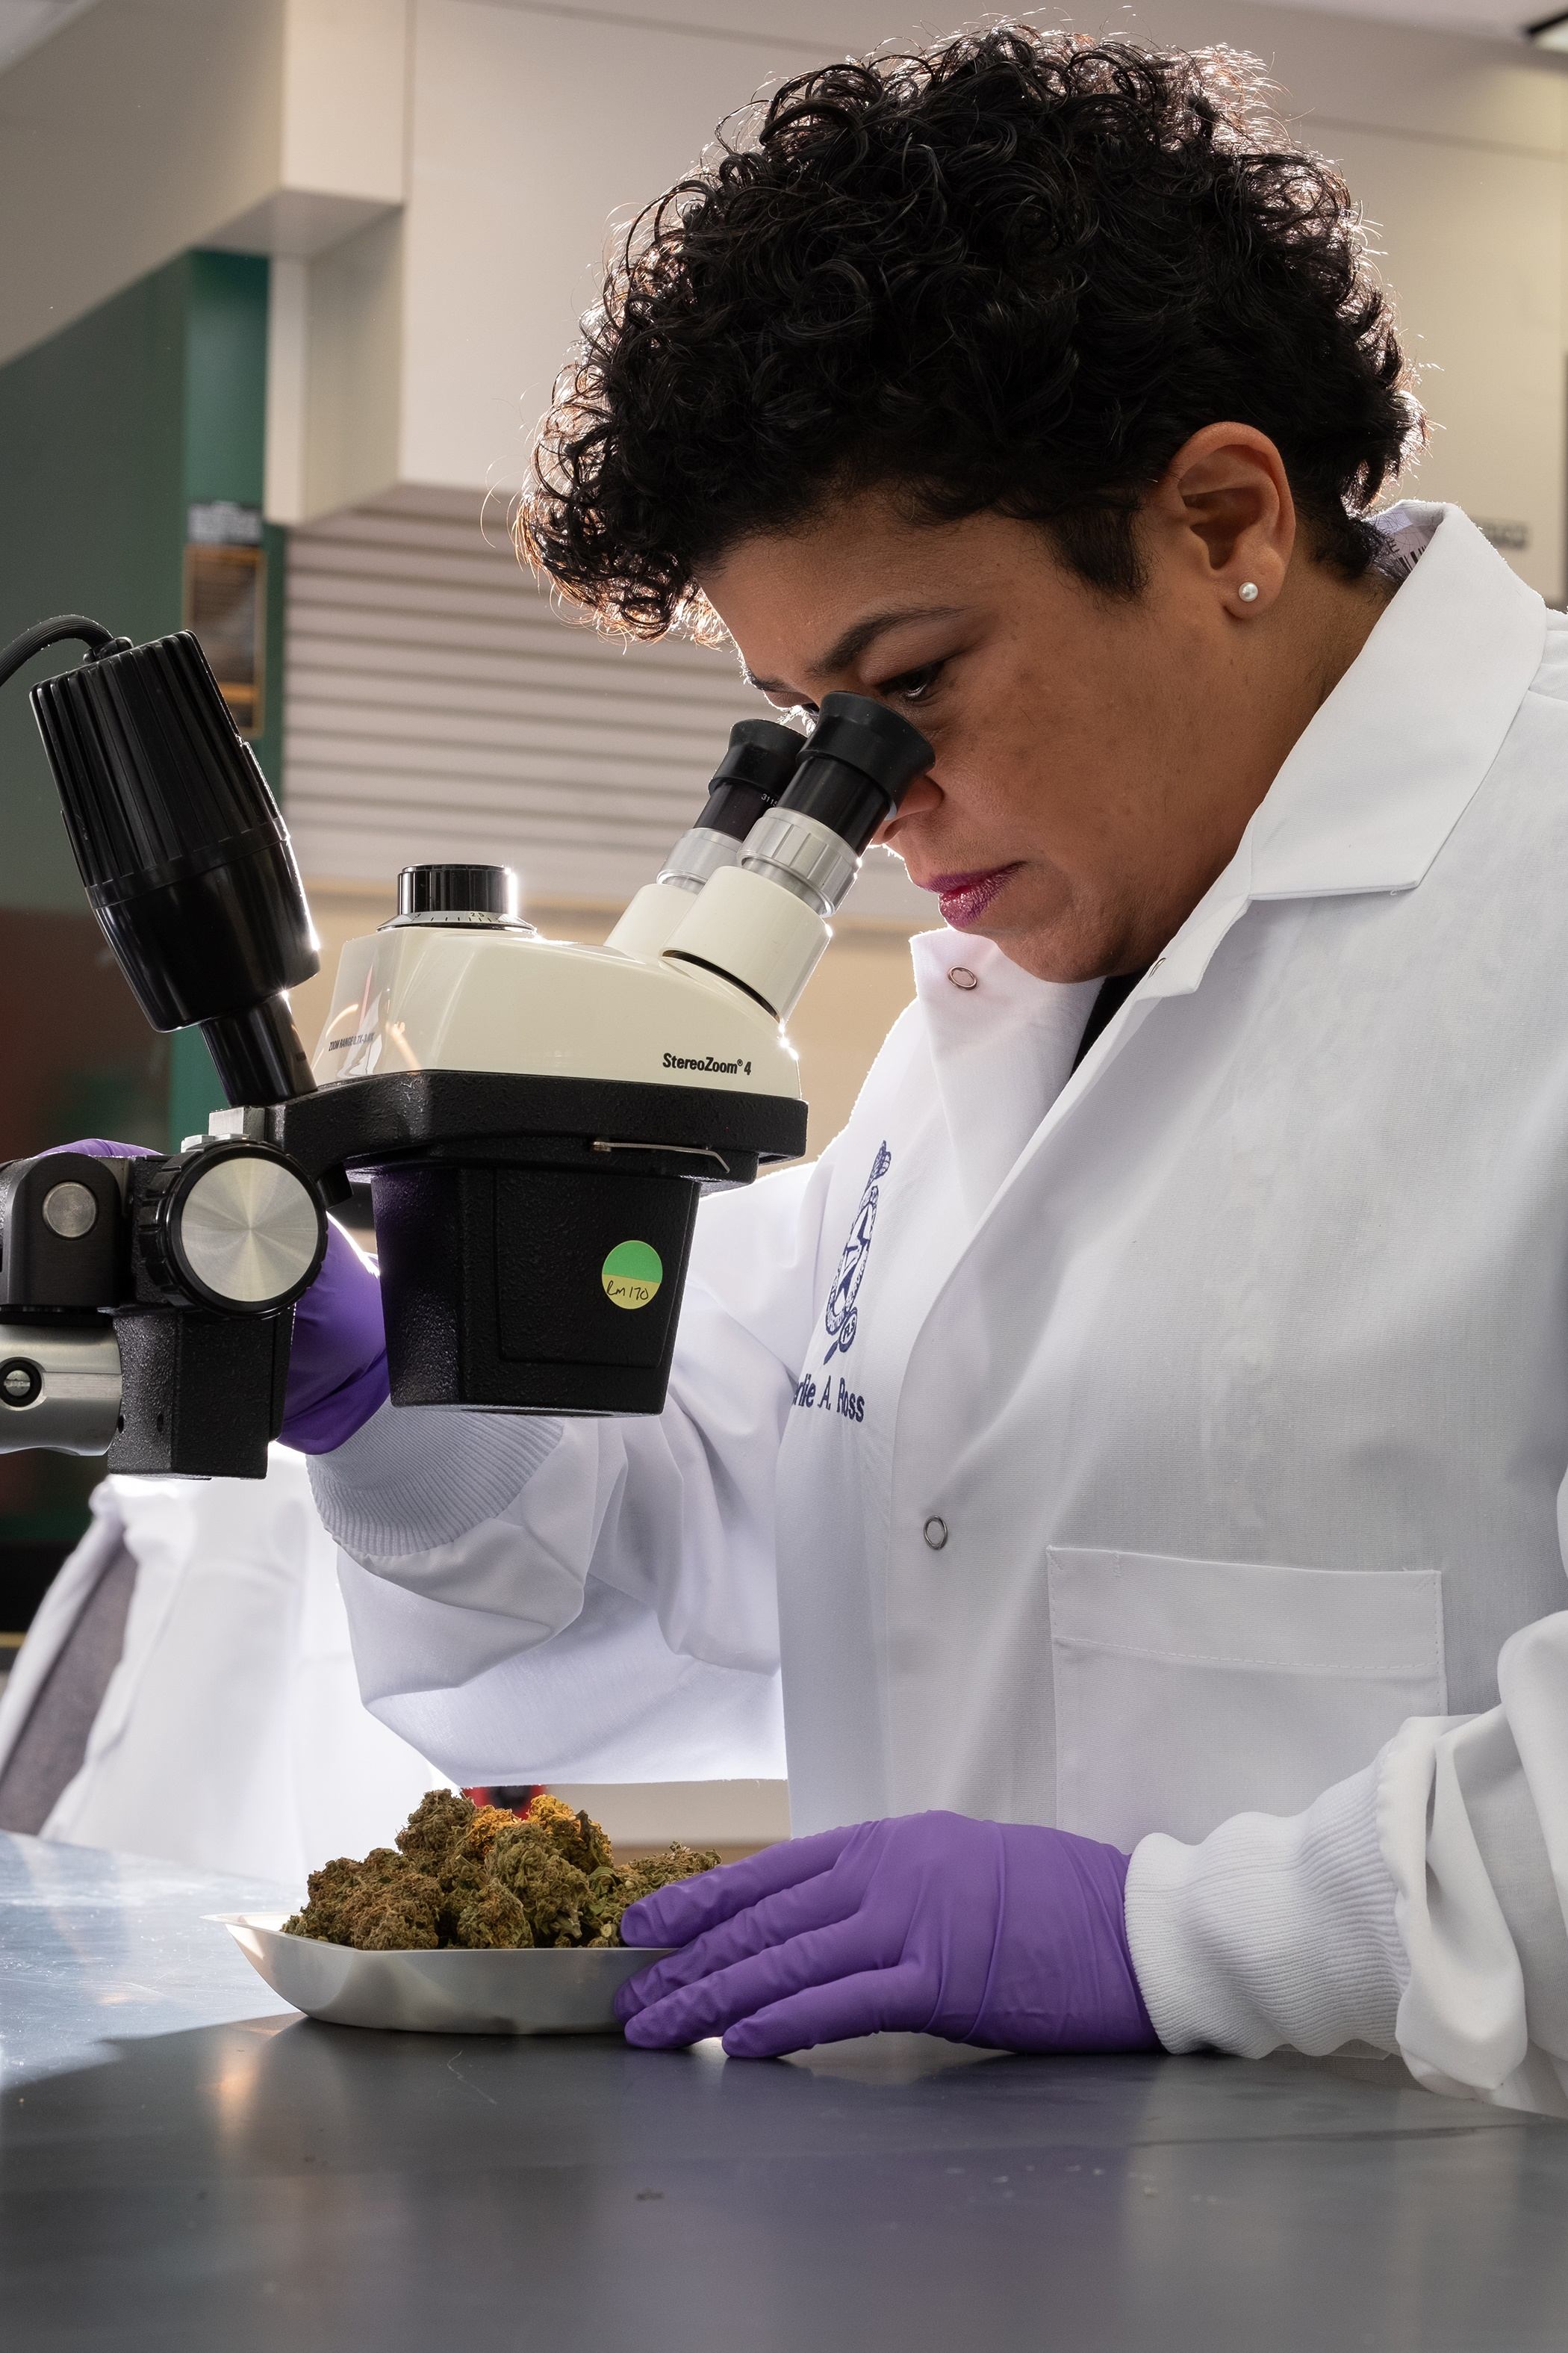
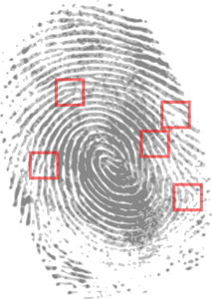
WHO WE ARE
FORENSIC INVESTIGATORS
Our mission is to conduct examinations and analyses of evidential items, offer expert testimony and provide training in support of Inspection Service Investigations.
Notes:
The Inspection Service also maintains a state-of-the-art National Forensic Laboratory in Dulles, Virginia, that helps to identify and ultimately provide evidence to successfully prosecute and convict individuals responsible for Postal-related criminal offenses. Its mission is to provide scientific and technical expertise to the criminal and security investigations of the Inspection Service.

Slide 11

WHO WE ARE
National Law Enforcement Communication Center
Located in Fort Worth, TX, and Dulles, VA
Maintains over 10,500 alarm panels, after hours phone coverage and in the event of an emergent situation, they dispatch the information to the appropriate duty inspector.
Notes:
NLECC is located in Fort Worth, TX and Dulles, VA. They maintain over 10.500 alarm panels, after hours phone coverage and in the event of emergent situations, they dispatch the information to the appropriate duty Inspector.

Slide 12

WHAT DOES IT ALL ADD UP TO?
MAIL DELIVERY POINTS: 160 MILLION
TAX DOLLARS
PIECES OF MAIL: 142.6 BILLION
ZERO!
U.S. POSTAL INSPECTION SERVICE EMPLOYEES: 2,425
POSTAL INSPECTORS: 1,262
INVESTIGATIONS: 5,964
ARRESTS: 5,759
Notes:
Mail Delivery Points: 160 Million
Piece of Mail: 142.6 Billion
USPIS Employees: 2,425
Postal Inspectors: 1,262
Investigations: 5,964
Arrests: 5,759
Tax Dollars Zero!

Slide 13

U.S. POSTAL INSPECTION SERVICE
Realistic Job Preview
Required to carry firearms
Inspectors are required to work an average of eight (8) hours per workday. Additionally, inspectors must meet the annual average minimum requirements of two (2) hours of available hours or unscheduled work hours per regular workday to receive Law Enforcement Availability Pay (LEAP).
Inspectors must be available when the unexpected occurs which may include nights, weekends, and holidays (on call 24/7, LEAP Policy)
Notes:
READ THE WHOLE SLIDE VERBATIM

Slide 14
U.S. POSTAL INSPECTION SERVICE
Realistic Job Preview
Inspectors are required to travel as needed
Inspectors may be required to work in undesirable areas and under adverse conditions
Inspectors do not receive overtime compensation or compensatory time – they are exempt from the provisions of the Fair Labor Standards Act (FLSA)
Notes:
READ THE WHOLE SLIDE VERBATIM

Slide 15
U.S. POSTAL INSPECTION SERVICE
Next Steps in Application Process
Assessment Center in Potomac, MD
Physical Fitness Test
Polygraph Examination
Management Interview
Selection Pool
Conditional Job Offer (based on needs of USPIS)
Background Investigation (Top Secret), Drug Testing, and Medical/Psychological Examinations
16-Week Basic Inspector Training (BIT) in Potomac, MD
Graduation from BIT is a CONDITION OF EMPLOYMENT
Post Basic Training at Division
Two-year Probationary Period from hiring date (one-year if Vet. Pref.)
USPS employees have a two-year Probationary Period
Notes:
Assessment Center – This will be a full day where you will participate in a variety of exercises where you’ll be assessed. If you pass, you will receive an email to attend the polygraph the next day.
Polygraph Exam – If you pass the polygraph, the next step will be a management interview. Which will be conducted locally, where you reside.
Management Interview – If recommended, you will be placed on a selection pool list.
Selection Pool List – This is a list you are placed on. You are not guaranteed a job. It is based on the needs of the USPIS.
Conditional Job Offer – You may receive a conditional job offer based on the needs of the USPIS. If you receive a conditional job offer, you will go through a background investigation, to include drug testing and a medical examination.
16 Week Basic Inspector Training – THIS WILL BE DISCUSSED IN MORE DETAIL IN THE NEXT SLIDES.
Post Basic Training – There are different tasks you will have to complete with a review panel.
Two Year Probationary Period – One Year if Veteran Preference (From Hiring Date)
USPS Employees have a Two-Year Probationary Period

Slide 16
U.S. POSTAL INSPECTION SERVICE
Polygraph Examination
Covers all information you have provided
Historically more than 50% of applicants are removed at the polygraph step
Consequences of failure of polygraph examination
Negative information discovered during the polygraph examination may be disclosed to current or potential law enforcement employers, as well as USPS.
Notes:
Importance of accuracy in application and information provided to USPIS
Consequences – you will be removed from the USPIS application process, Information will be available to other agencies that are conducting background examinations.
If you have failed another polygraph, you must disclose it.
Failures are typically from not providing complete and accurate information as requested on the application
Many issue arise from failure to accurately report drug use

Slide 17
U.S. POSTAL INSPECTION SERVICE
Drug policy
Used, ingested, or possessed marijuana, including for medical purposes, within the three (3) years preceding the date of the application for employment.
The various forms of marijuana include cannabis, hashish, hash oil, and tetrahydrocannabinol (THC), in both synthetic and natural forms.
Used, ingested, or possessed any illegal drug or controlled substance, other than marijuana, or misused legal drugs or controlled substances, within the seven (7) years preceding the date of the application for employment (including misuse of prescription and nonprescription drugs).
Ever been involved in the illegal sale, manufacture, cultivation, trafficking, or production of a drug or controlled substance (including marijuana).
Notes:
Importance of reporting all instances of drug use as required by the policy.
Better to disclose early.
Drug use is not an automatic disqualifier.
All applicants are reviewed based on individual situations and information provided.

Slide 18
U.S. POSTAL INSPECTION SERVICE
Basic Inspector Training (BIT)
16-week residential program at the Inspection Service Career Development Unit, Potomac, MD (a suburb of Washington D.C.)
Five areas of basic instruction:
  Academics
  Firearms
  Physical Fitness
  Control Tactics
  Practical Exercises
Notes:
READ THE SLIDE VERBATIM

Slide 19
U.S. POSTAL INSPECTION SERVICE
Unsuccessful Completion of BIT
Postal Employee
You will be provided a 30-day notice period
No automatic retreat rights to the Postal Service position held
It is your personal responsibility to find another Postal Service position
If you are unsuccessful in obtaining another position, you will be terminated from the Postal Service
Notes:
READ THE SLIDE VERBATIM

Slide 20
U.S. POSTAL INSPECTION SERVICE
Unsuccessful Completion of BIT
Non-Postal Service Employees
You will be separated from the Postal Service
There are no programs or provisions to assist you in returning to your former place of employment, or assisting you in finding other employment
Notes:
READ THE SLIDE VERBATIM

Slide 21
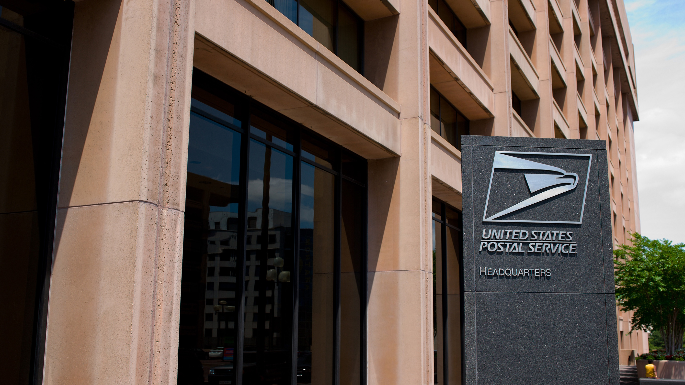
Any
Questions?
Notes:
ANY QUESTIONS

Slide 22
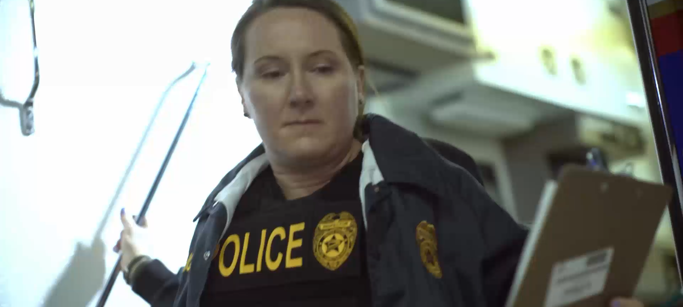






For more information go to www.uspis.gov Follow us on:

